Slide 1

KCA UNIVERSITY | BSc INFORMATION TECHNOLOGY
Pharmacy POS
Management System
A Modern Solution for MedPlus Pharmacy
RALPH OSIKO
23/08138
JACOB OLOO
Student
Registration
Supervisor

Slide 2
SECTION 01
Background & Project Idea
Proposed Solution
Information technology has transformed healthcare operations, particularly in retail pharmacy services. Medicine dispensing and sales transaction management are key areas affected by these advancements.
A Pharmacy Point of Sale (POS) system is a computerized solution that enables pharmacies to process sales transactions, manage medicine inventory, track expiry dates, handle prescriptions, and generate reports efficiently.
In today's competitive healthcare environment, accurate and fast transaction processing is essential for customer satisfaction, patient safety, and effective pharmacy management.
A computerized Pharmacy POS Management System designed to streamline operations, minimize losses from expired medicines, ensure regulatory compliance with Pharmacy and Poisons Board of Kenya, and enhance decision-making.
Sales Processing
Inventory Mgmt
Prescription Tracking
Real-time Reports
Expected Outcomes
Enhanced accuracy
Faster transactions
Reduced errors
Better compliance

Slide 3
SECTION 02
Problem Statement & Objectives
Core Problems
Main Objective
To design and implement an efficient Pharmacy POS Management System for MedPlus Pharmacy that automates sales transactions, medicine inventory management, and prescription tracking.
1
Manual Systems
Prone to errors in pricing and calculations
2
Poor Inventory Tracking
No real-time stock level monitoring
3
Expiry Date Failures
Specific Objectives
Risk of dispensing expired medicines
1
Sales Processing
2
Inventory Management
4
Delayed Reporting
Record and process pharmacy sales accurately including prescription and OTC medicines
Real-time stock updates with expiry date tracking and automated alerts
Manual report generation is time-consuming
5
Prescription Issues
Difficulty managing prescription records
3
Prescription Management
4
Automated Reporting
Record prescription details and link to sales transactions
Generate sales, inventory, and expiry reports for decision-making
5
User-Friendly Interface
Impact: Financial losses, poor customer service, regulatory compliance issues, and inefficient operations
Design intuitive interface enhancing ease of use and efficiency for pharmacy staff

Slide 4
SECTION 03
Literature Review
Commercial Systems
Technology Stack
McKesson Pharmacy Systems
Python/PHP/Java
Django/Laravel/React
Comprehensive but expensive, designed for large chains
Backend Languages
Frameworks
Liberty Software
MySQL/PostgreSQL
Client-Server
POS, prescription & inventory management with high costs
Databases
Architecture
mPharma (Africa)
Supply chain focus, specific business model limitations
Research Gaps Identified
RxNova POS
Prescription & OTC sales but licensing fees prohibitive
1.
Cost Barrier
Expensive systems unaffordable for small pharmacies
2.
Complexity
Open-Source Solutions
Enterprise systems too complex for small operations
3.
Context Specificity
OpenMRS & Bahmni
Western-designed systems don't fit Kenyan requirements
Hospital-focused, too complex for retail pharmacies
4.
Expiry Management
Limited expiry tracking in basic POS systems
Odoo POS
5.
Integration Gap
Customizable but requires technical expertise
Lack of affordable standalone systems
Conclusion: Need for affordable, user-friendly, context-specific pharmacy POS system tailored for community pharmacies in Kenya

Slide 5
SECTION 04
Methodology
System Architecture
Waterfall Model
1
Requirements Analysis
Client Layer
Application Layer
Database Layer
2
System Design
Web browser interface for users (Admin, Pharmacist, Cashier)
Server-side logic processing requests and business rules
Persistent storage for medicines, sales, prescriptions, users
3
Implementation
4
Testing
5
Deployment
System Modules
6
Maintenance
1. Authentication
2. Inventory
3. Sales
Login, roles, security
Stock, expiry, alerts
Transactions, receipts
Testing Strategy
4. Prescription
5. Reporting
6. User Mgmt
Unit Testing
Records, compliance
Sales, inventory, expiry
Add, update, logs
Individual modules
Integration Testing
Module interactions
Technology Stack
System Testing
Python 3.x
Django 4.x
HTML/CSS/JS
SQLite/MySQL
Complete application
Backend
Framework
Frontend
Database
UAT
Pharmacy staff testing

Slide 6
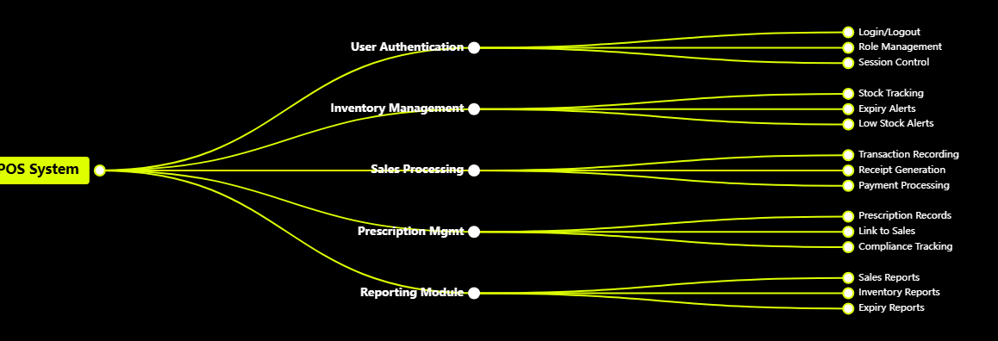
SECTION 05
System Flow Diagram
User Roles
Data Flow
Security
Admin, Pharmacist, Cashier with role-based access control
Real-time updates across all modules with centralized database
Authentication, authorization, and audit trails for compliance

Slide 7
Thank You
Questions & Discussion
RALPH OSIKO
JACOB OLOO
Student
Supervisor
23/08138
KCA University | BSc Information Technology

